Slide 1
Indian stock market simulator and its Implementation on a Local Network
By: Shubham Sharma (181434)
Apoorav Chaudhary(181371)

Slide 2
About
Our project “Indian Stock Market Simulator” is based upon Web Development and Computer Networking. In the web development part, we have created a Website Indian Stock Market Simulator is a website in which, users can create their account free of cost and doesn’t need to add their real money. Our interface isn’t connected to any stock exchange, so user won’t be trading actual stock, just practicing as if they are, although stock prices are fetched using python in real time and will replicate the original price of the stock in real time. As for the Computer Networks part we have created a Local DNS, a local Domain Name Server which will be able to resolve the Domain Names into the IP addresses, in this local network. Using Network Switch configuration, we configured our nodes to use our local DNS as the primary DNS of each node. So, when any node enters a domain name in their browser the request will be resolved by our local DNS. We have used Bind9 DNS.

Slide 3
Problem Statement
The problem statement to our project can be defined as following; As we already know, due to the current condition of the country, economy isn’t doing so well, and as a result people were and are being laid off from their jobs and as a result, we have seen a huge rise in unemployment. Many tried to earn their living through stock market without any prior knowledge of it. Some people actually made money but the number of people who lost money was way higher. And the possible reason or the problem here was lack of knowledge or practice. Which can be stated as the problem statement of our project, when we look more into this problem and tried to find a solution, there weren’t many, as they required money or there were some other problems. So, we defined this as the main problem and sought out for a solution and tried to make one of our own, through this project.

Slide 4
Requirements (Software and Hardware)
Hardware Technologies: ​
Network Switch
Category 6 Cable (Cat 6)
Server and Client Computers
Software Technologies:
HTML
CSS
Bootstrap
JavaScript
Php (Hypertext preprocessor)
MySQL
Python
Bind9

Slide 5
1
Flowcharts & Algorithms
Network & DNS Configuration
Indian Stock market simulator
2
3

Slide 6
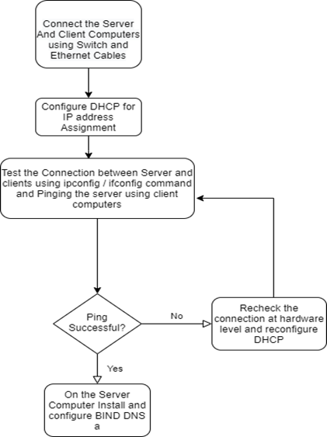
Flowchart (Hardware)

Slide 7
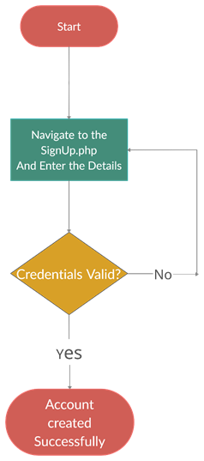
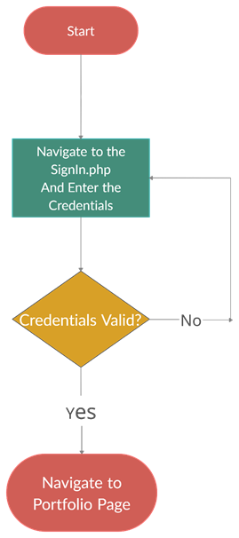
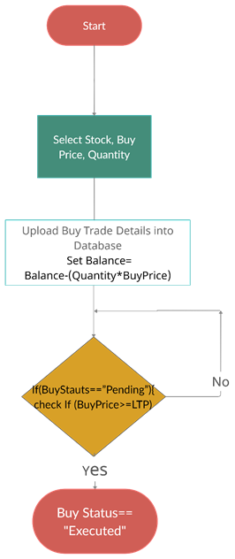
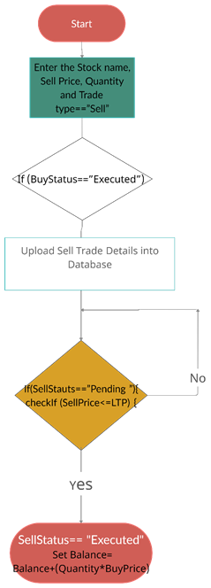
Flowchart (Software)
Sign Up
Sign In
Buy Trade
Sell Trade

Slide 8
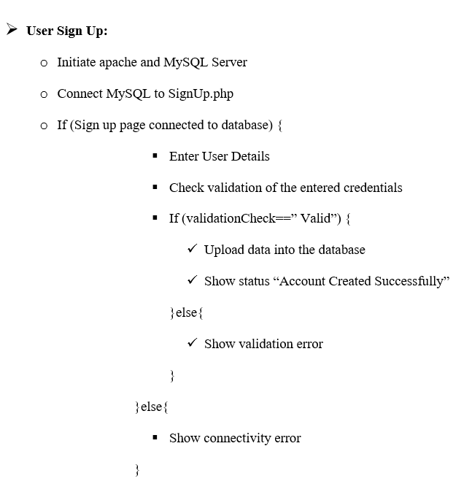
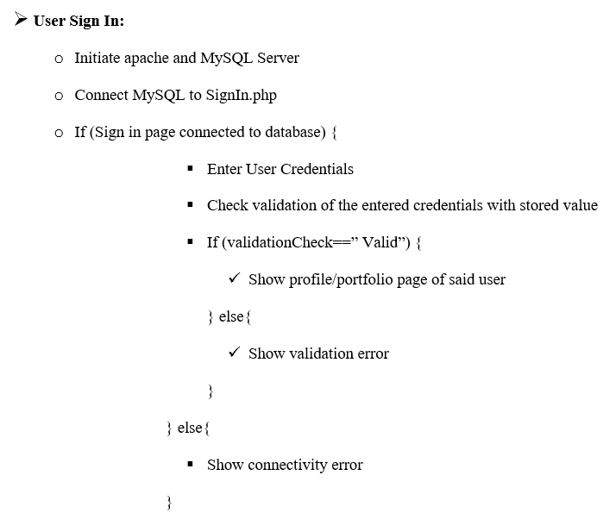
Algorithms

Slide 9
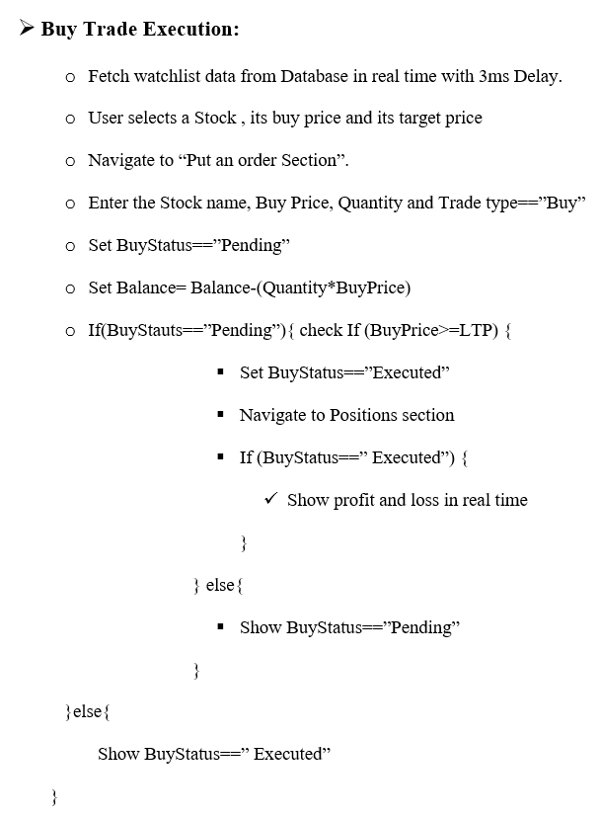
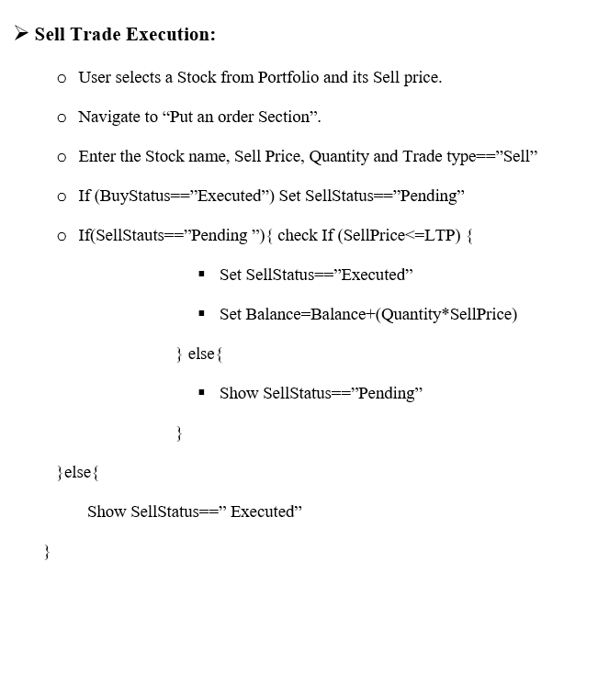
Algorithms

Slide 10
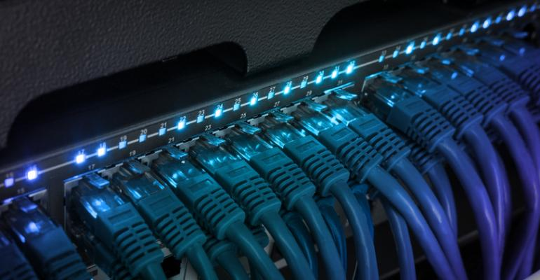
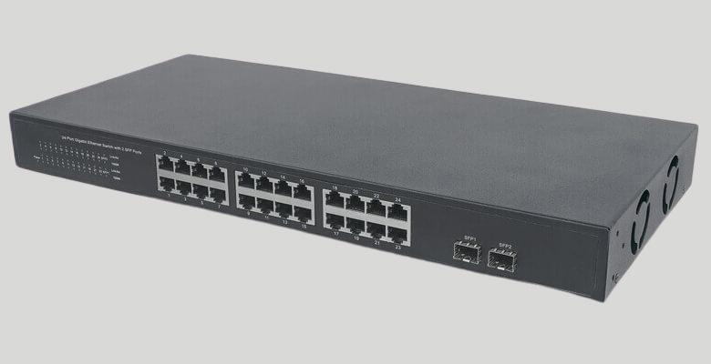
Network Configuration
At this stage, we configured the local network, we can use a Network Switch to connect the nodes with each other.
The Above images shows how, a network switch looks, nodes are connected to the switch with Ethernet Cables into RJ45 ports and hence to each other.

Slide 11
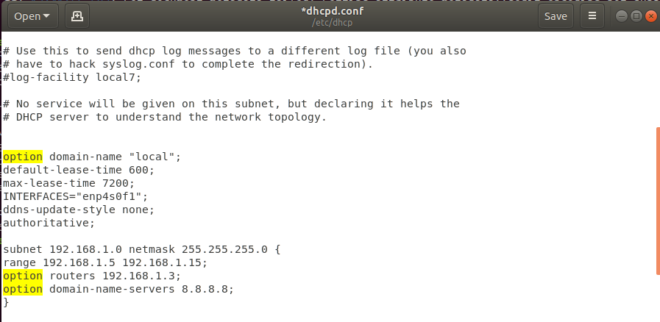
Next up, we will create a DHCP Server and assign the IP addresses to every node of the same class. To Setup the DHCP Server, we followed the following process:
$ sudo apt get update (Updates the Linux Repository)
$ sudo apt-get install isc-dhcp-server –y (Install the dhcp server)
$ ip a (Noting the Server IP and NIC Number)
$ sudo gedit /etc/dhcp/dhcpd.conf (Configure the DHCP)
In this file, we have set the range of the IP addresses which can be assigned to the nodes and the IP address of the Server itself. The file looks like following after the edits:

Slide 12
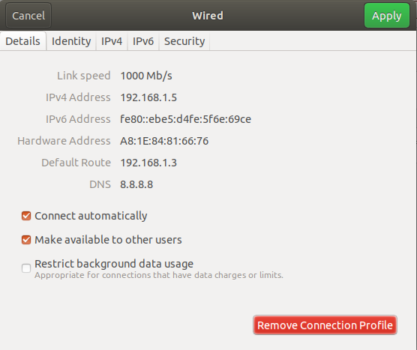
$ sudo systemctl restart isc-dhcp-server.service (with this command we can restart the DHCP Server)
After this, we configured the nodes to use DHCP to get the IP addresses and the result looks like following:
As we can see, the above node has been assigned an IP Address set under the Range. Hence, we can say that the DHCP has been configured.

Slide 13
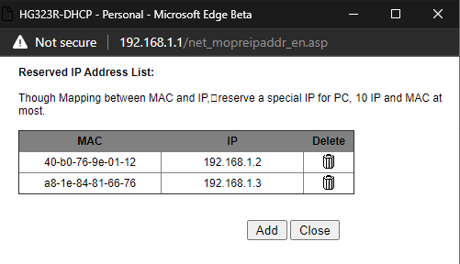
DNS Installation
At this stage, we will install DNS Server, firstly, we will Set a Static IP Address for the DNS Server and Web Server.

Slide 14
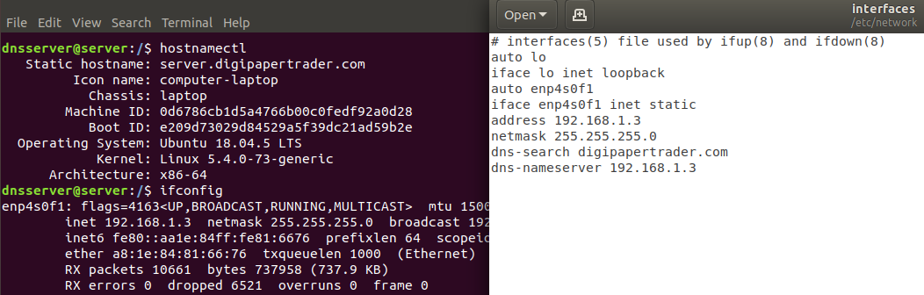
$ hostnamectl (Checking the existing hostname)
$ hostnamectl set-hostname server.<domain-name>.com
$ ifconfig (Note the IP Address and NIC Name)
$ sudo gedit /etc/network/interfaces (Add the NIC name and IP of DNS to the Interfaces file) file look like following:
$ sudo systemctl restart networking
$ sudo apt update

Slide 15
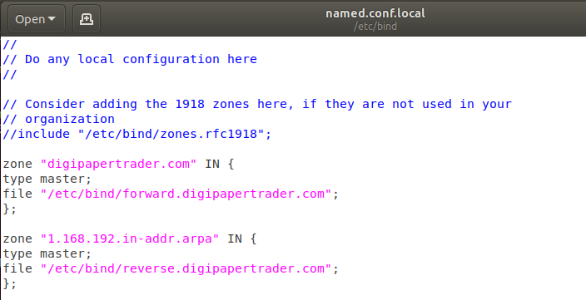
$ sudo apt install bind9 bind9utils (Install BIND9 DNS Server)
$ cd /etc/bind/
$ cat named.conf
$ sudo gedit /etc/named.conf.local (add the forward and reverse zones along with Domain Name)
The file named.conf.local should look like following:

Slide 16
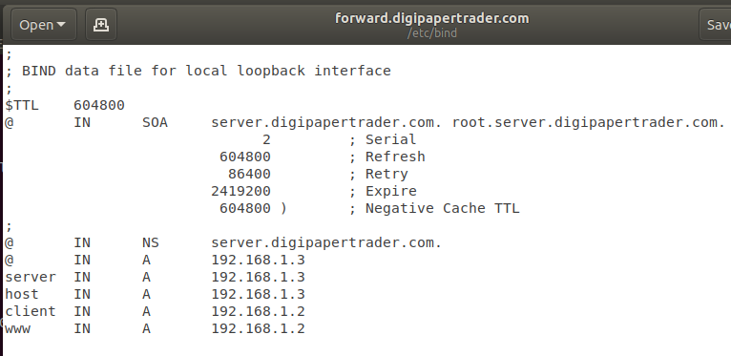
$ sudo cp db.local forward.<domain-name>.com (Create a forward zone)
$ sudo gedit forward.<domain-name>.com (add server, client and host IPs to the forward zone)
Forward zone file will look like this.
$ sudo cp forward.<domain-name>.com reverse.<domain-name>.com (create a reverse zone)

Slide 17
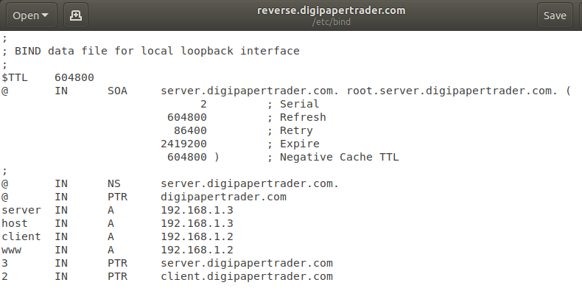
$ sudo gedit reverse.<domain-name>.com (add server, client and host IPs to the Reverse zone)
Reverse zone file will look like this.

Slide 18
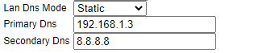
$ sudo systemctl start bind9
$ sudo chown -R bind:bind /etc/bind
$ sudo chmod –R 755 /etc/bind
$ sudo systemctl status bind9
$ sudo systemctl enable bind9
$ sudo ufw status
$ sudo ufw allow bind9
$ sudo systemctl restart networking
$ sudo systemctl restart NetworkManager
DNS Server have been installed and configured successfully, now we need to edit the Router/Network switch and set local DNS as the Primary DNS.
Restart the router/network switch.

Slide 19
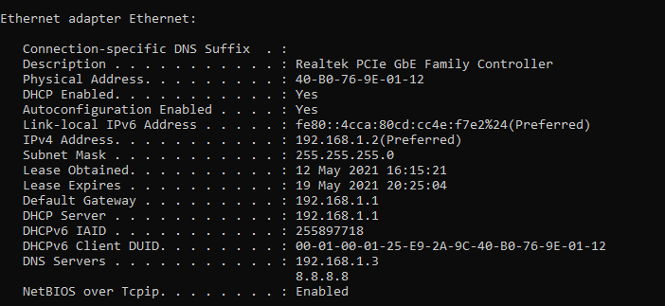
Testing
Check DNS server on a connected node.
Ipconfig /all
As we can see, the default DNS Server is the Local DNS we created

Slide 20

Homepage
It’s the main page of our website , it’s the first page which will appear when user enters the website.

Slide 21
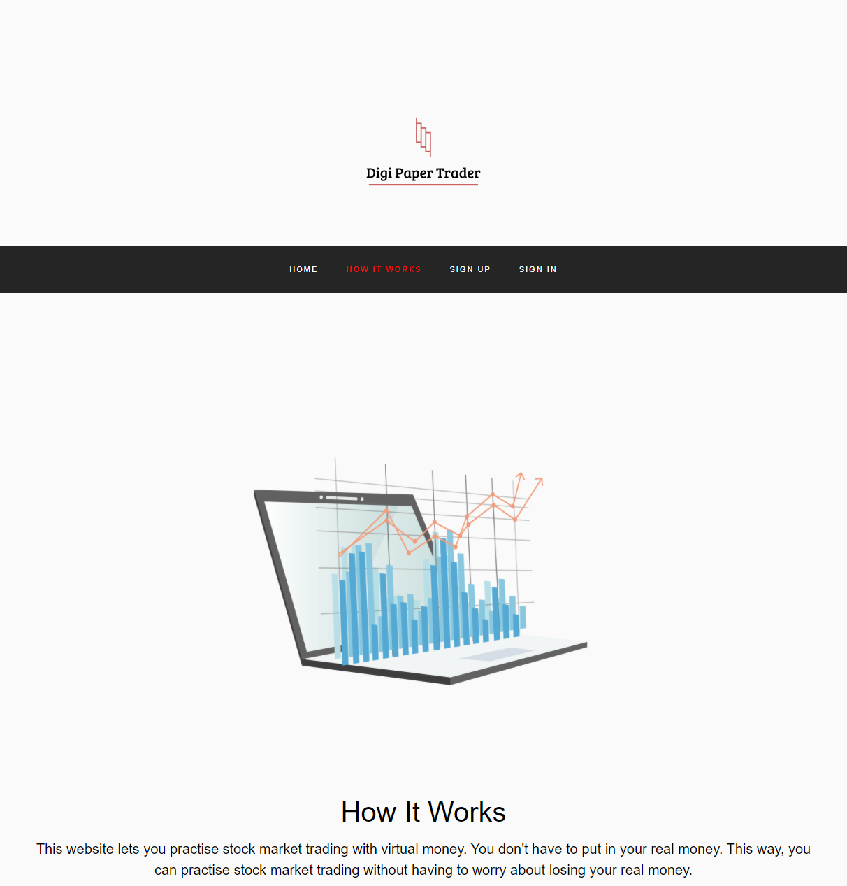
How it works
This page describes how our website works.

Slide 22
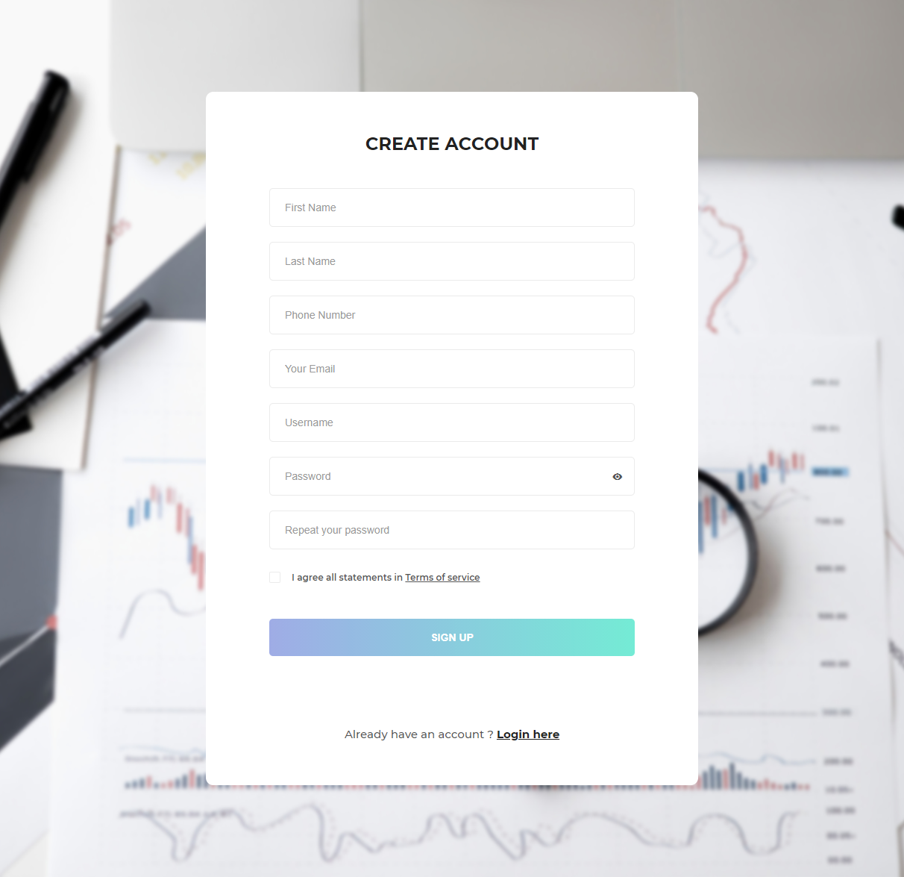
Sign Up
This page contains a form which can be used to create an account.

Slide 23

Sign In
This page, contains a form which is used to log in to the account.

Slide 24
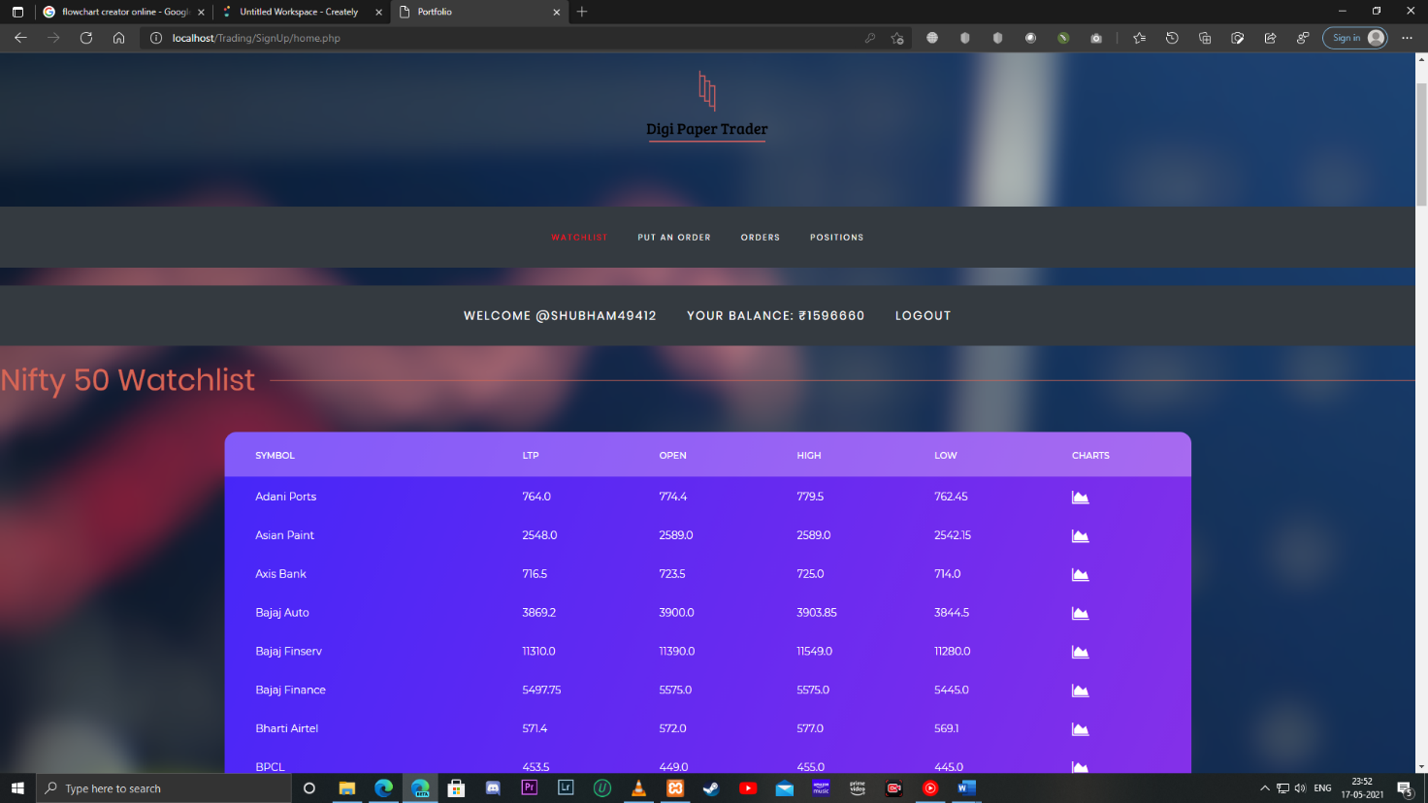
Portfolio-Watchlist
This part of the portfolio displays the stocks and their LTPs.

Slide 25
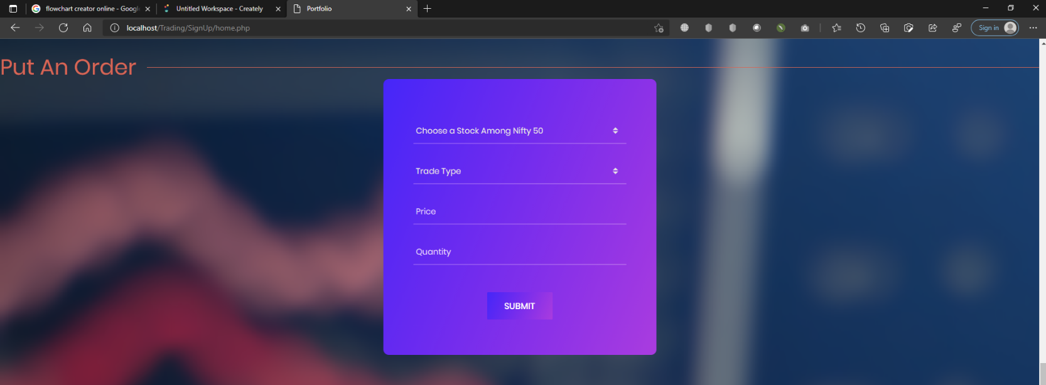
Portfolio-Put an order
This part of the portfolio contains a form to put an order, either buy or sell.

Slide 26
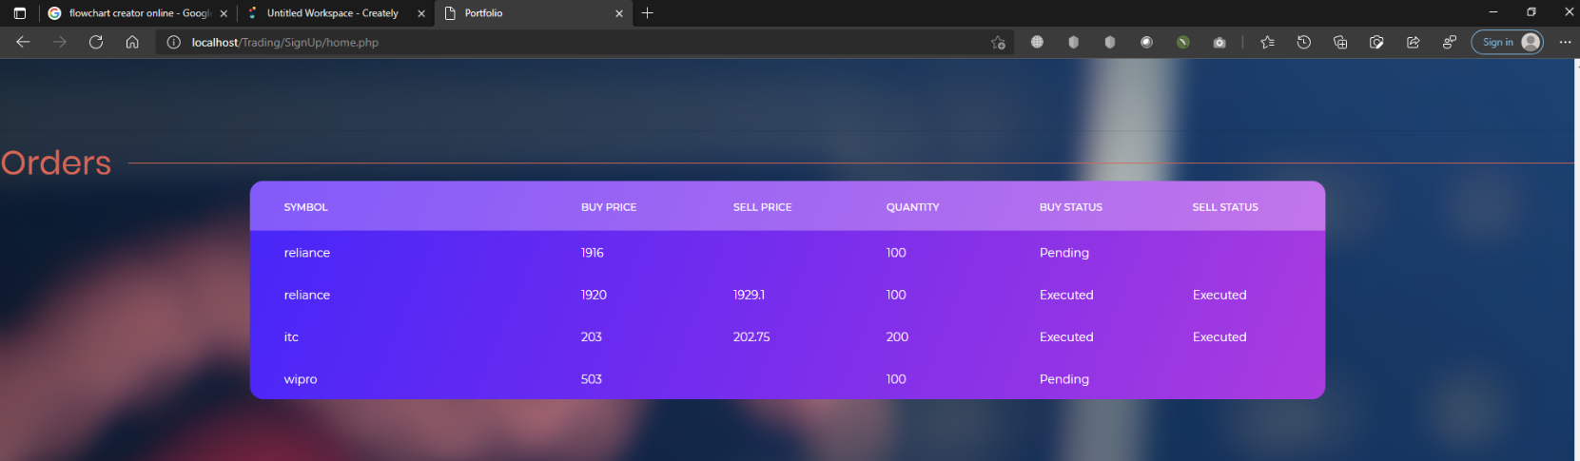
Portfolio-Orders
This part of the portfolio displays the orders user have entered.

Slide 27
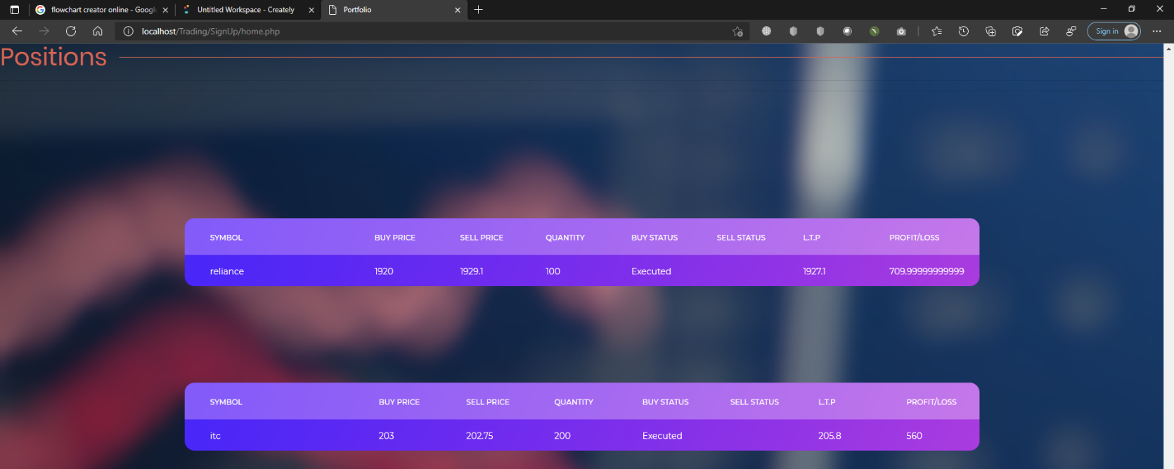
Portfolio-Positions
This part of the portfolio displays the positions, i.e, Profit and Loss.

Slide 28
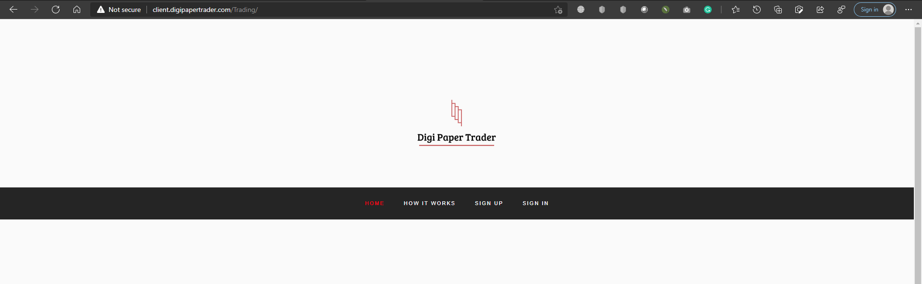
Testing

Slide 29
Thank You

